Slide 1
Crypto 101
&
Password Cracking
v1.0

Slide 2
So, what is crypto ?
Study of techniques for secure communication!

Slide 3
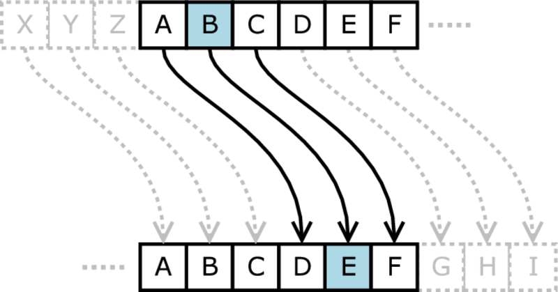
Most Popular Example
Julius Caesar was using “Mono Alphabetic Substitution cipher” algorithm known as “Ceaser Cipher” .

Slide 4
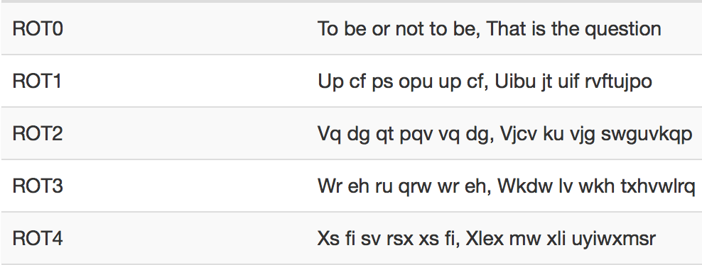
Ceaser ROTs

Slide 5
What is the “problem” with Ceaser Cipher ?

Slide 6
But, wait...
There is an “Information Leakage”..!

Slide 7
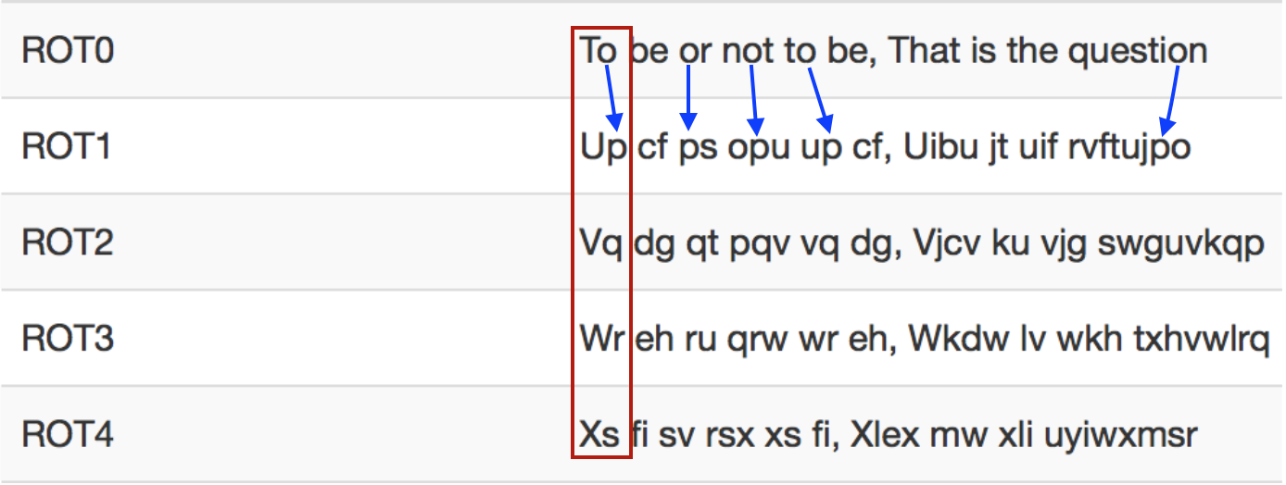
Ceaser Cipher Problem(s)

Slide 8
We knows;
Lengths are fixed.
Each plain-text has only one cipher-text representation.
Frequency!

Slide 9
A first technique: Frequency Analysis
“The methodology behind frequency analysis relies on the fact that in any language, each letter has its own personality. The most obvious trait that letters have is the frequency with which they appear in a language. Clearly in English the letter "Z" appears far less frequently than, say, "A". “

Slide 10
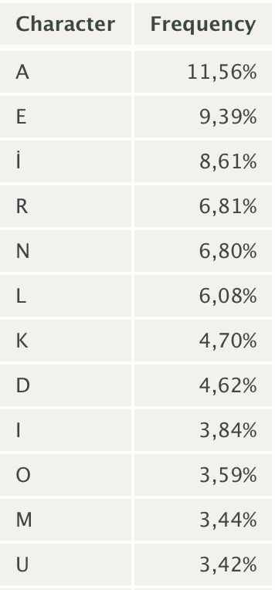
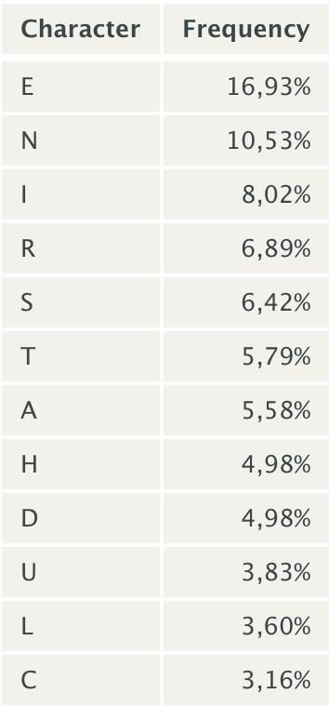
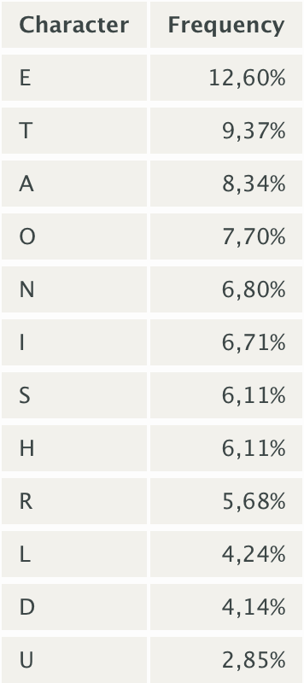
Letters Frequency Table (Tr, De, En)

Slide 11
It’s bird. It’s a planet... It’s a PUZZLE..!

Slide 12
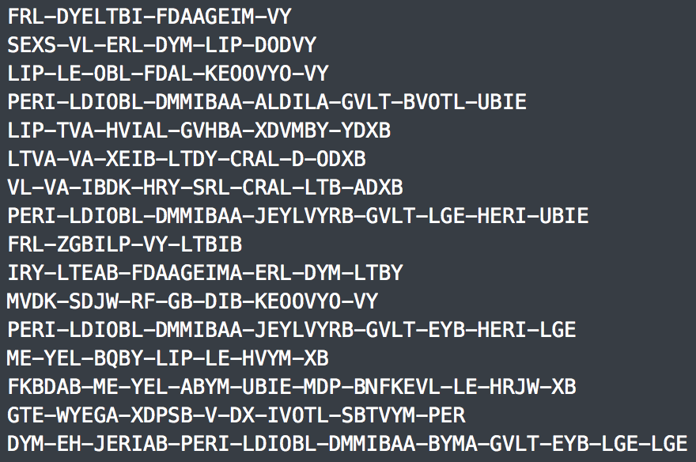
Demo
https://www.mehmetince.net/mdisectf-0x01-bga-powerbank-odullu-ctf-kazananlari

Slide 13
http://quipqiup.com/index.php

Slide 14
Demo
Finished (4.996 seconds)

Slide 15
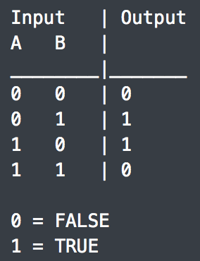
Exclusive OR a.k.a XOR

Slide 16
More Information About XOR
1 - Core Operations
0 ⊕ 0 = 0
0 ⊕ 1 = 1
1 ⊕ 0 = 1
1 ⊕ 1 = 0
2 - Substituion
a ⊕ b = b ⊕ a
3 - Zero
a ⊕ a = 0
4 - Self XOR
a ⊕ 0 = a
Example
a ⊕ b ⊕ a = b
Proof:
a ⊕ b ⊕ a = b
a ⊕ a ⊕ b = b
0 ⊕ b = b
b=b

Slide 17
Why we are using XOR ?

Slide 18
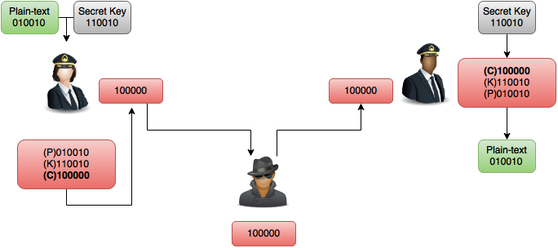
Encryption With XOR

Slide 19
Word most secure Encryption. OTP & XOR
One Time Password a.k.a OTP is a designed by Gilbert Vernam in 1918.
Do NOT use Private-Key twice during secure communication.

Slide 20
Why we shouldn’t use Private-Key twice ?

Slide 21
K is a Private-Key string.
P is a Plain-Text string.

Slide 22
Using Private Key Twice
P is a Plain-Text data.
C is a Cipher-Text (encrypted) data.
K is a secret key data.
So…
We are assuming that two different plain-text -for example P2 and P7- are encrypted with same K key.
Eve(MITMer) knows C2 and C7.
C2 ⊕ C7
( P2 ⊕ K ) ⊕ ( P7 ⊕ K )
P2 ⊕ P7 ⊕ K ⊕ K
P2 ⊕ P7 ⊕ 0
P2 ⊕ P7

Slide 23
So… What ?

Slide 24
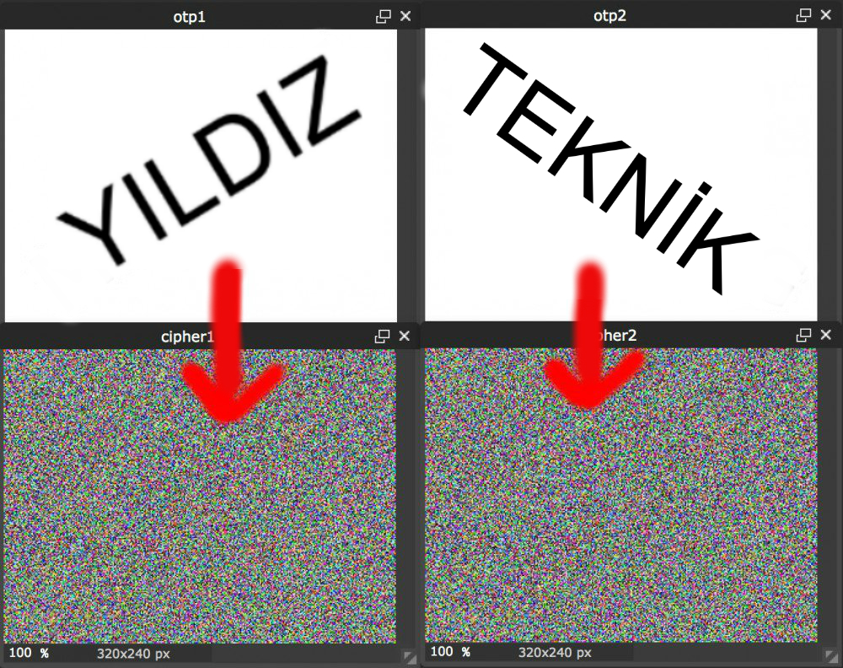
Using Private Key Twice

Slide 25

Using Private Key Twice

Slide 26
Symmetric & Asymmetric Encryption

Slide 27
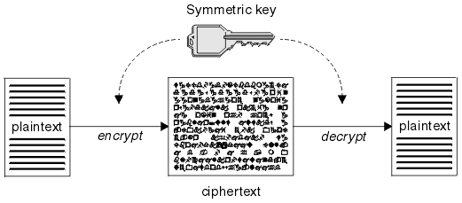
Symmetric Encryption
Symmetric encryption is the oldest and best-known technique.

Slide 28
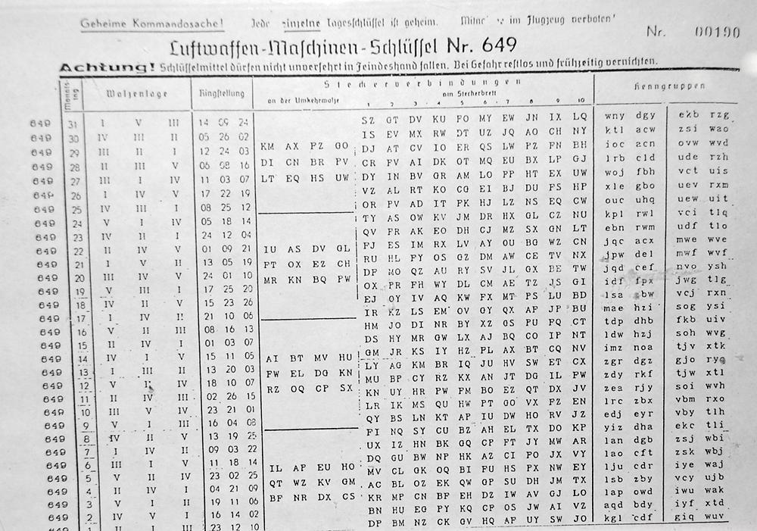

Symmetric Encryption

Slide 29
Block Ciphers
~ Members of Symmetric-Encryption familiy.
~ Plain-text and Private-Key will be divided fixed lenght.
~ There shouldn’t be a relation between Cipher-Text <> Private-Key
~ 1 bit changes must affects, at least half of the plain-text

Slide 30
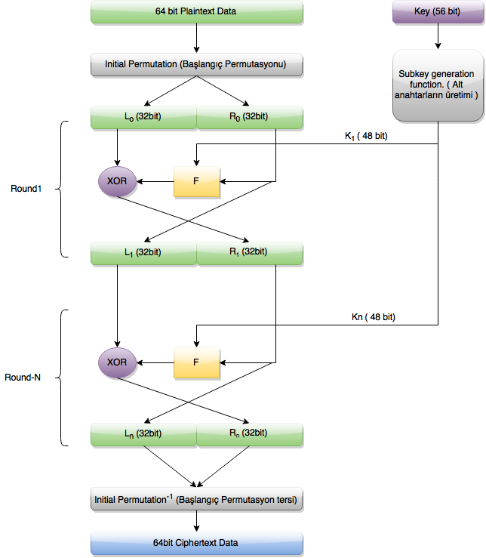
DES
Notes:
IBM develop etti

Slide 31
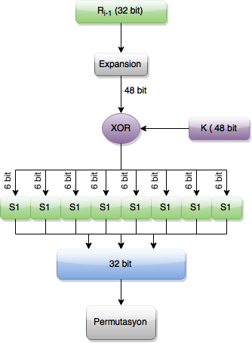
DES F-box

Slide 32
DES Cracking Contest
2^56 = 72,057,594,037,927,936 ~ 72 quadrillion possibilities.
DES Challenges #1 = 1997 and took 96 days.
DES Challenges #2 = 1998 and took 39 days. The secret message is: Many hands make light work.
DES Challenges #3 = 1998 and took 56 hours.The secret message is: It's time for those 128-, 192-, and 256-bit keys.
DES Challenges #4 = 1999 and took only 22 hours 15 mins. The secret message is...

Slide 33
See you in Rome (AES Conference, March 22-23, 1999)

Slide 34
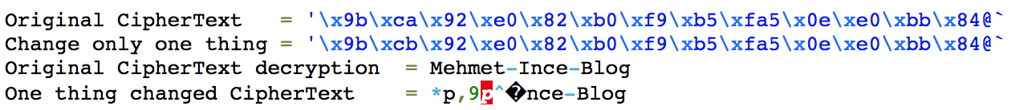
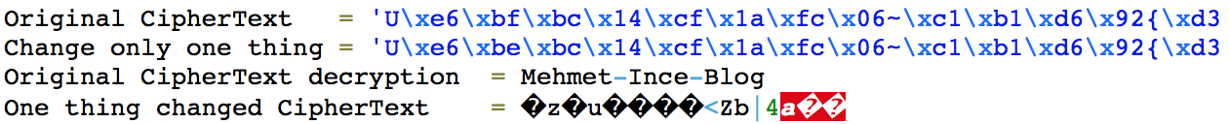
1 Bit Changes Affects
DES
AES

Slide 35
AES
Joan Daemen & Vincent Rijmen from Leuven, Belgium
128, 192 and 256 bit key length mods.
Announced by NIST (National Institute of Standards and Technology) at November 26, 2001.
AES became effective as a federal government standard on May 26, 2002 after approval by the Secretary of Commerce.

Slide 36
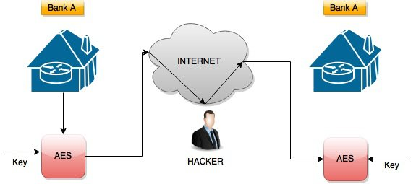
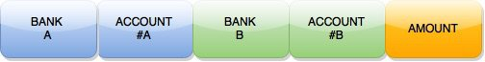
Encryption

Slide 37
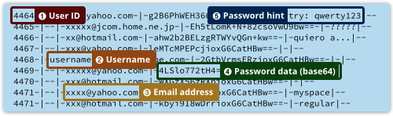
Example - Adobe Massive Leak
38.000.000 Adobe customer passwords, emails, names and their password reminders was leaked.
Adobe was using 3DES encryption on these fields..!

Slide 38
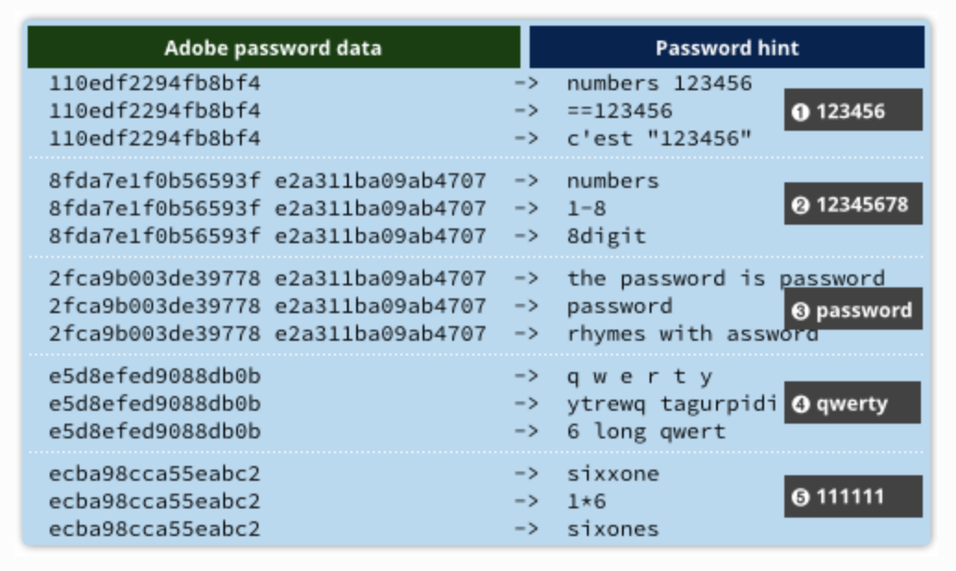
Example - Adobe Massive Leak
38.000.000 Adobe customer passwords, emails, names and their password reminders was leaked.
Adobe was using 3DES encryption on these fields..!

Slide 39
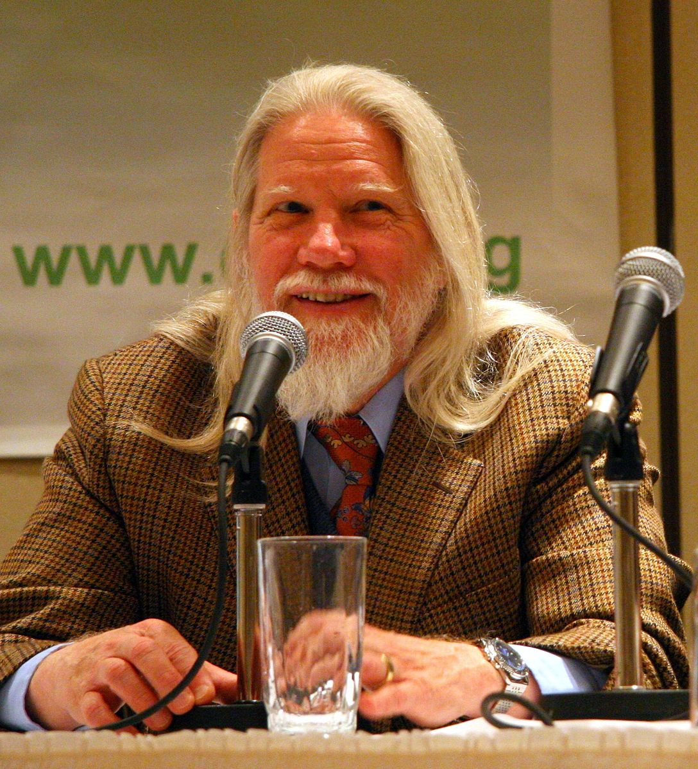
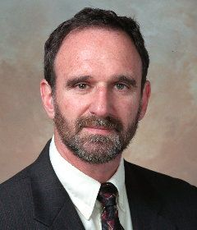
Asymmetric Encryption
Whitfield Diffie & Martin Hellman from Stanford University.

Slide 40
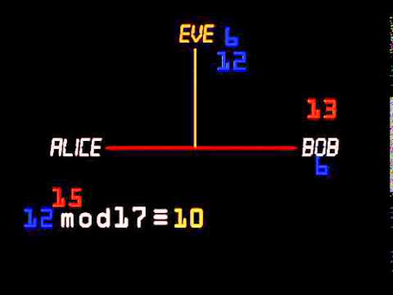
How does it work ?

Slide 41
What is Encoding ?

Slide 42
Base64
Original Text :
A long time ago in a galaxy far far away
Encoded :
QSBsb25nIHRpbWUgYWdvIGluIGEgZ2FsYXh5IGZhciBmYXIgYXdheQ==

Slide 43
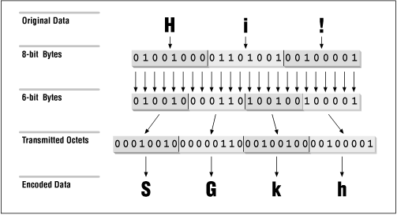
Base64

Slide 44
What is Hash ?

Slide 45
Where/why we gonna use it ?

Slide 46
MD5 / SHA1

Slide 47
Known Issues
Too fast
Collision Attack
about MD5 / SHA1

Slide 48
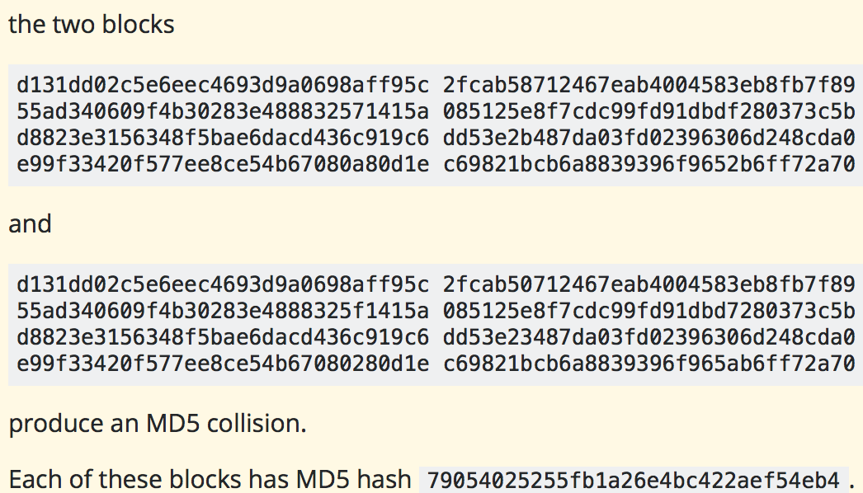
Collision Attack

Slide 49
Rainbow Attack

Slide 50
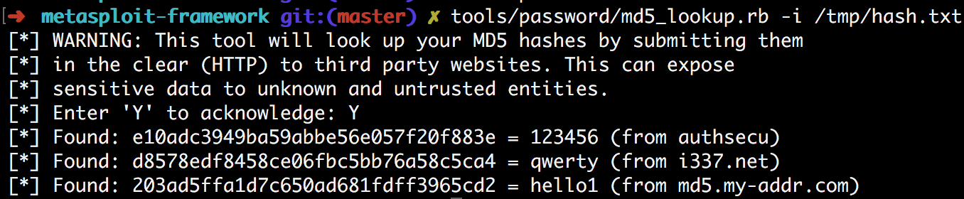
Rainbow Attack

Slide 51
Brute-Force Attack
MD5 possibilities
~ a-f
~ 0-9
16^32 120,892,581,961,462,917,4706,176

Slide 52
Using GPU

Slide 53
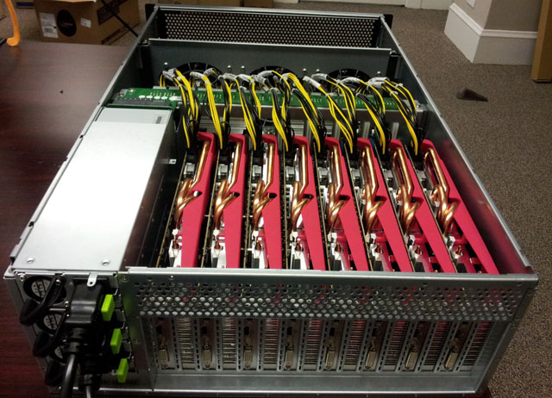
GPU Cluster

Slide 54
(180,000,000,000) billion! per second

Slide 55
Moar! Speed...

Slide 56
Tool: Hashcat

Slide 57
Hashcat
~ Free
~ and Open-source Now! (https://github.com/hashcat/)
~ Uses OpenCL
~ Multi-threading support
~ Window & Linux fully supported. (Bonus: Now supports FreeBSD & OSX.)
~ Complex.

Slide 58
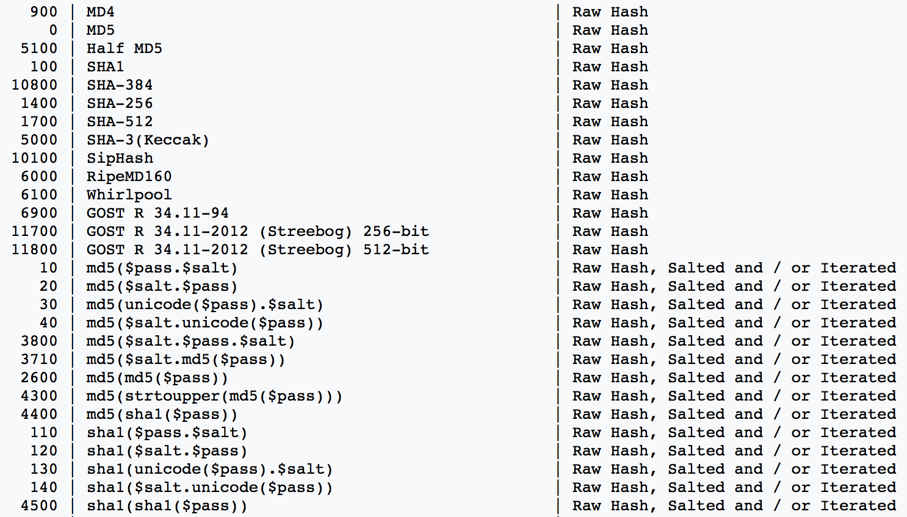
Hashcat Supported Types - 1

Slide 59
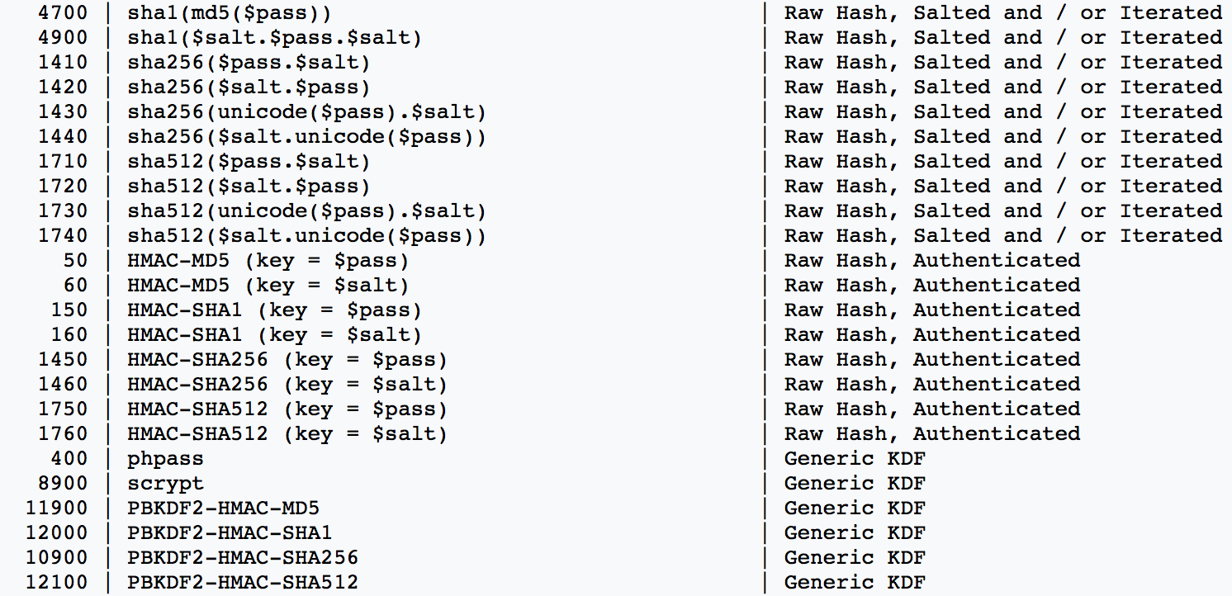
Hashcat Supported Types - 2

Slide 60
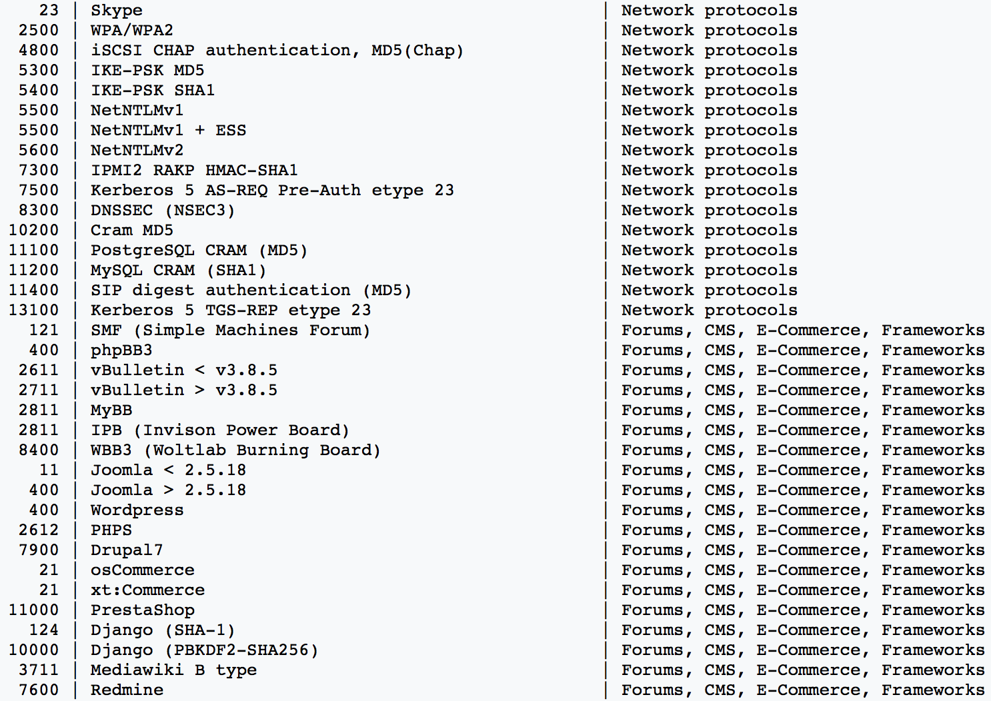
Hashcat Supported Types - 3

Slide 61
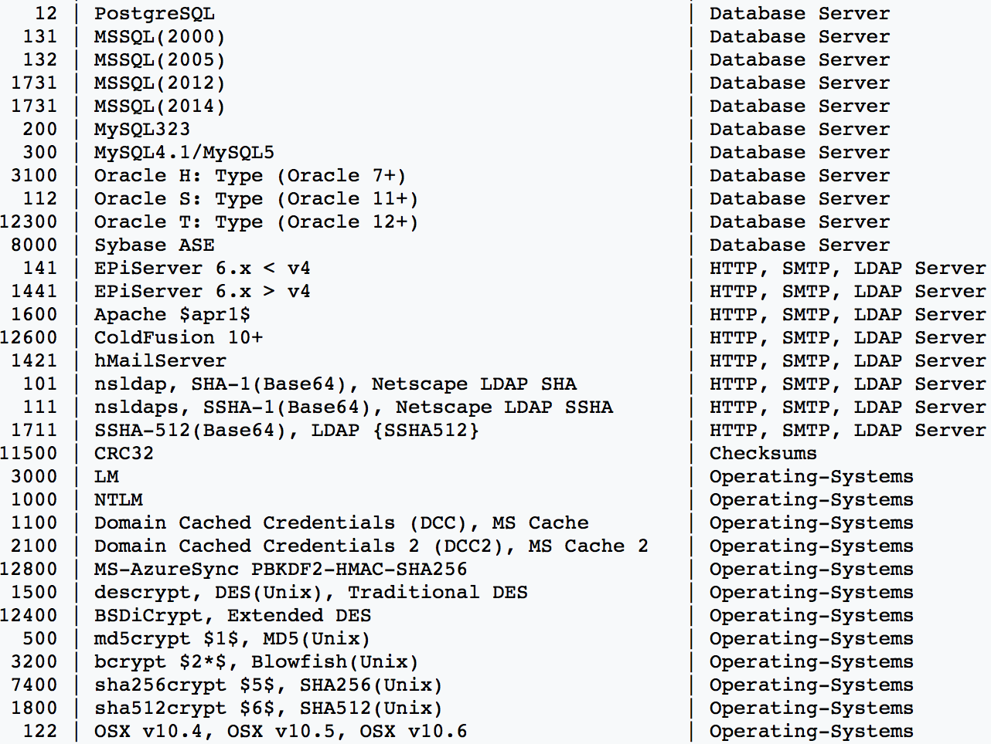
Hashcat Supported Types - 4

Slide 62
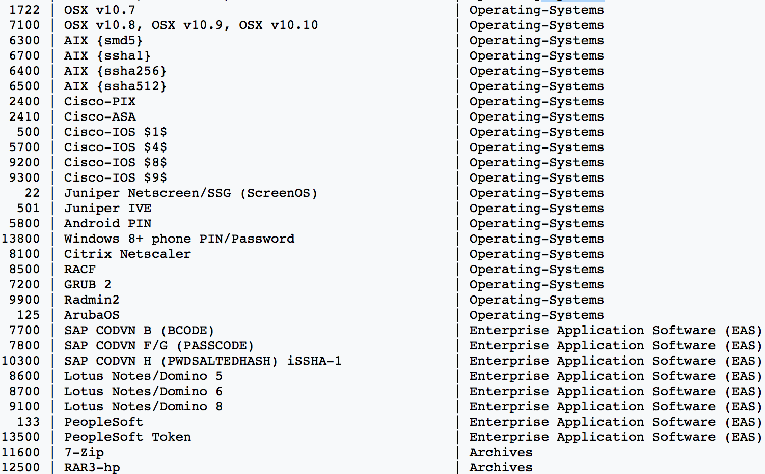
Hashcat Supported Types - 5

Slide 63
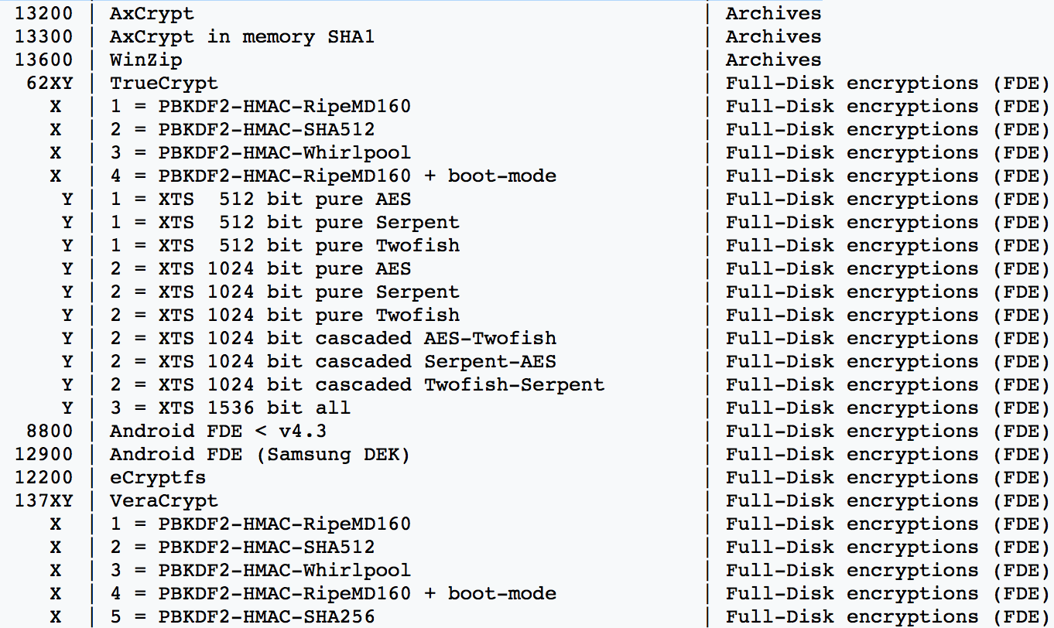
Hashcat Supported Types - 6

Slide 64
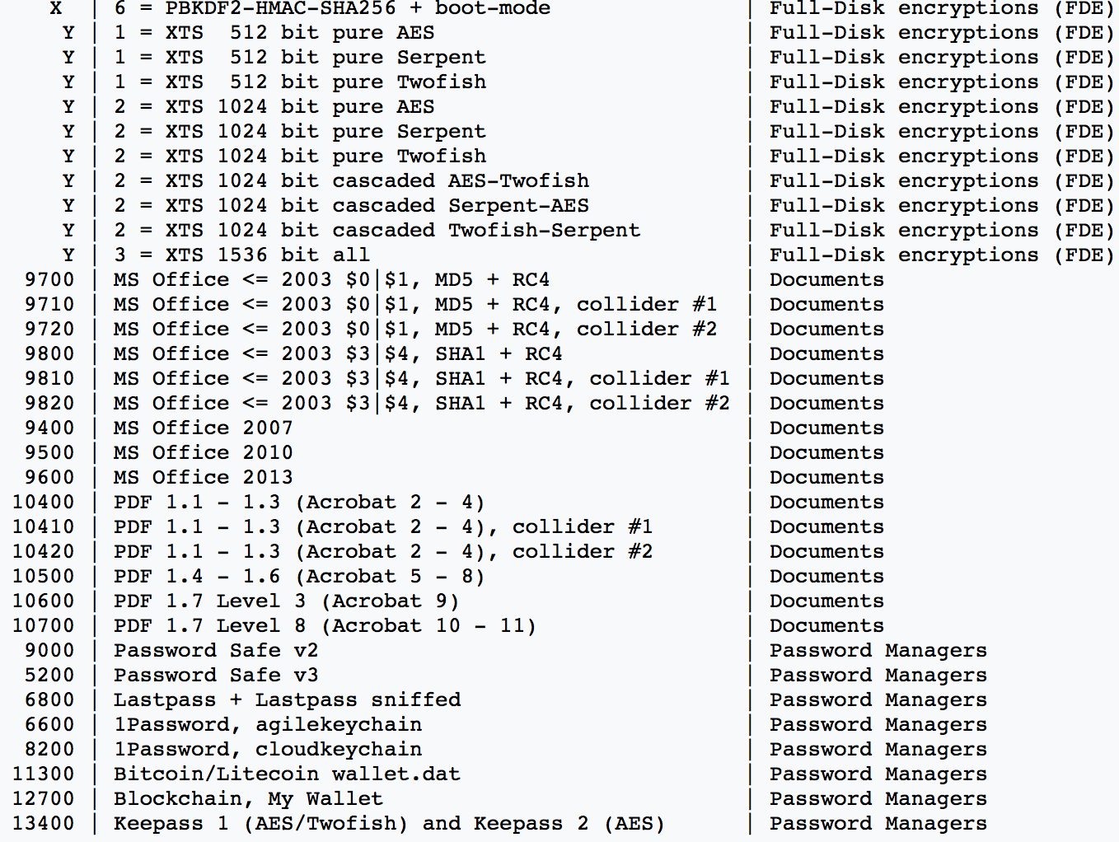
Hashcat Supported Types - 7

Slide 65
Brute-Force Techniques
Dictionary Attack
Combinator Attack
Mask Attack
Hybrid Attack
Rule-Based Attack

Slide 66
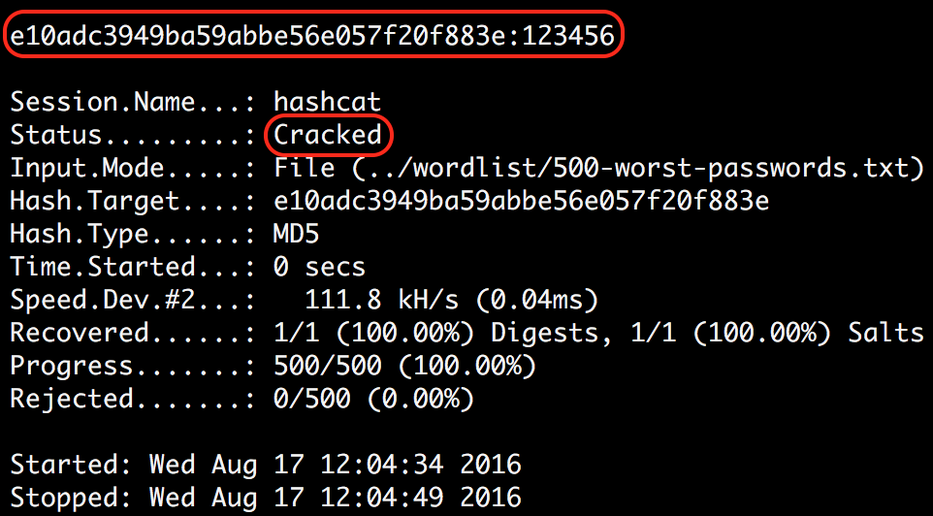
Dictionary Attack
It’s also known as Wordlist Attack.

Slide 67
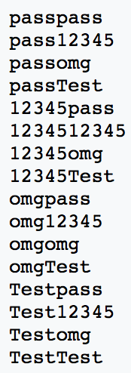
Combinator Attack
Your wordlist:
pass
12345
omg
pass

Slide 68
Mask Attack
Let’s say the password length is 9, so we have to iterate through 9^62 (13.537.086.546.263.552) combinations. Lets say we crack with a rate of 100M/s, this requires more than 4 years to complete.

Slide 69
Mask Attack
In Mask attack, we know about humans and how they design passwords.
~ People usually use word + number format.
~ Also first letter is generally upper-case
Example: Julia1984

Slide 70
Mask Attack
To make it short, with Mask attack we can reduce the keyspace to
52*26*26*26*26*10*10*10*10 (237.627.520.000)
With the same cracking rate of 100M/s,
this requires just 40 minutes to complete.

Slide 71
Hybrid Attack
Combinator + Wordlist Attack
Your wordlist:
hello
password
Hashcat Cmd:
-a 6 example.dict ?d?d?d?d
Your wordlist:
password0000
password0001
password0002

